Slide 1
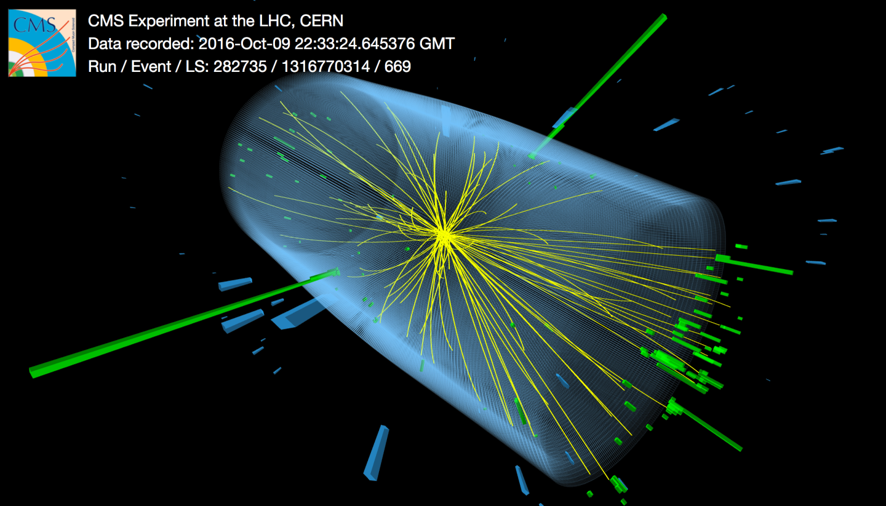
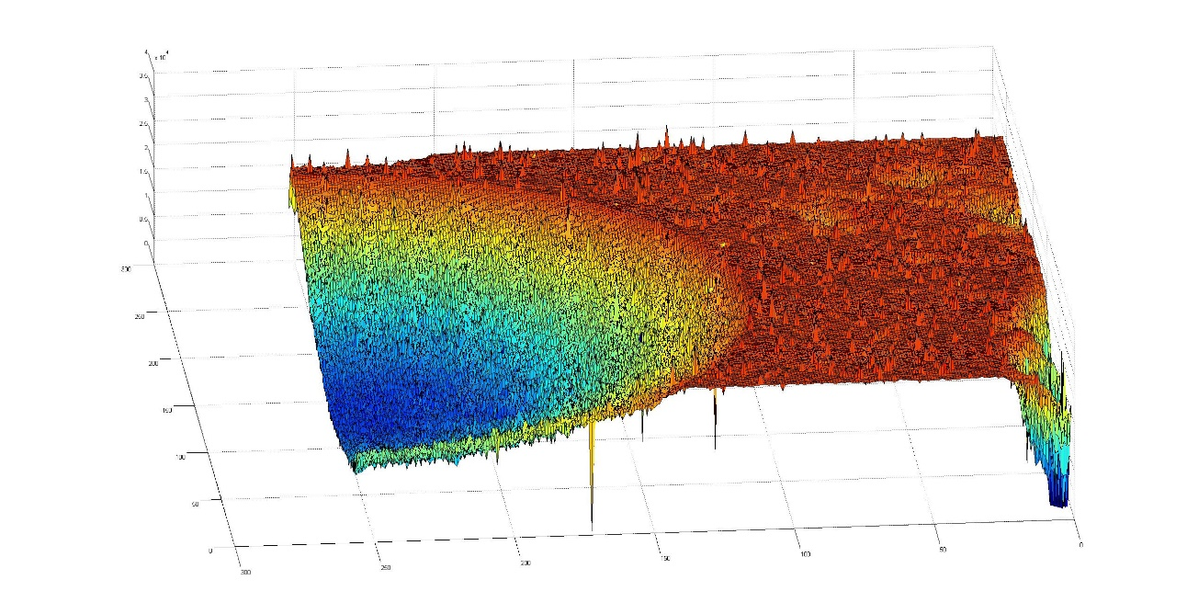
TCT characterization and scanning of fine pitch of n+-in-p pixel detectors
M. Bezak ¹⁾, S. Bharthuar ²⁾, V. Chmill ¹⁾, E. J. Brücken ²⁾, A. Gädda ^{2,3)}, J.Härkönen ¹⁾, M. Kalliokoski ⁵⁾, A. Karadzhinova-Ferrer ¹⁾, S. Kirschemann ²⁾, J. Ott ²⁾,
V. Litichevskyi ^{2,4)}, P. Luukka ²⁾
¹⁾ Ruđer Bošković Institute, Bijenička cesta 54, 10000 Zagreb, Croatia
²⁾ Helsinki Institute of Physics, Finland
³⁾ Advacam Oy, Tietotie 3, FI-02150 Espoo, Finland
⁴⁾ Specom Oy, Tekniikantie 2 A 326, 02150 Espoo, Finland
⁵⁾ Aalto Univesity, Espoo, Finland
contact: name + @helsinki.fi or @irb.hr
http://lnr.irb.hr/PaRaDeSEC/
http://research.hip.fi/hwp/cmsupg/
https://www.aalto.fi/en/otanano
http://www.micronova.fi/
Spatially resolved Charge Collection Efficiency (CCE) of a
pixel detector. The signal is created by 2 MeV proton beam

Slide 2
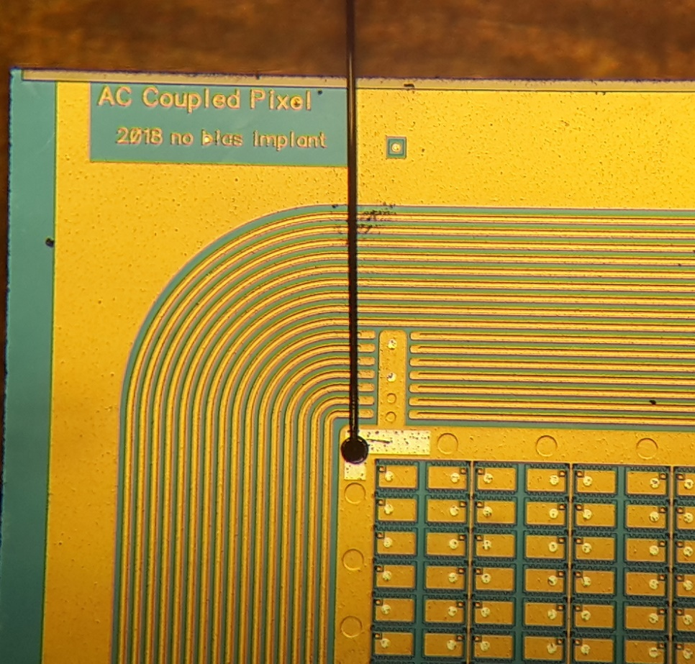
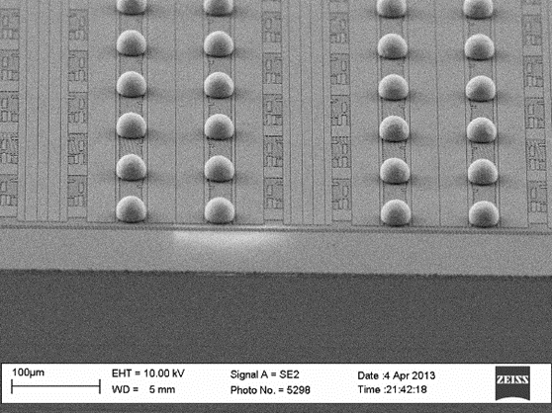
Outline
Pixel detector design and layout
AC-coupled pixel sensor, 100×150 µm pitch to match PSI46dig
DC-coupled pixel sensor, 50×50 µm pitch to match RD53A
Processing of detectors
TCT characterization and selected results
Image Processing
High resolution area scans
Summary

Slide 3
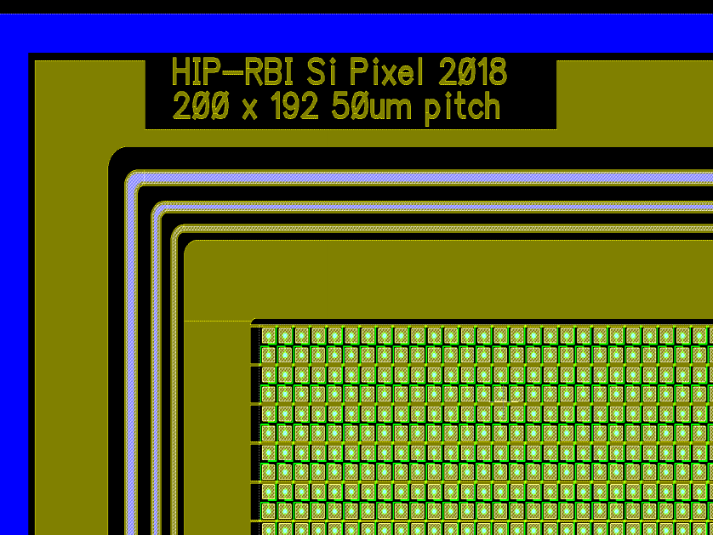
Detector design – RD53 pixel detector
1st level – Implant
2nd level – contact opening
to field insulator
3rd level – bias resistor
made of TiN deposited by Atomic
Layer Deposition (ALD) method
RD53 = CERN joint collaboration developing future
CMOS read-out ASIC for all LHC experiments. Chip consist
of 400 x 192 = 76 800 pixels
4th level – metals

Slide 4
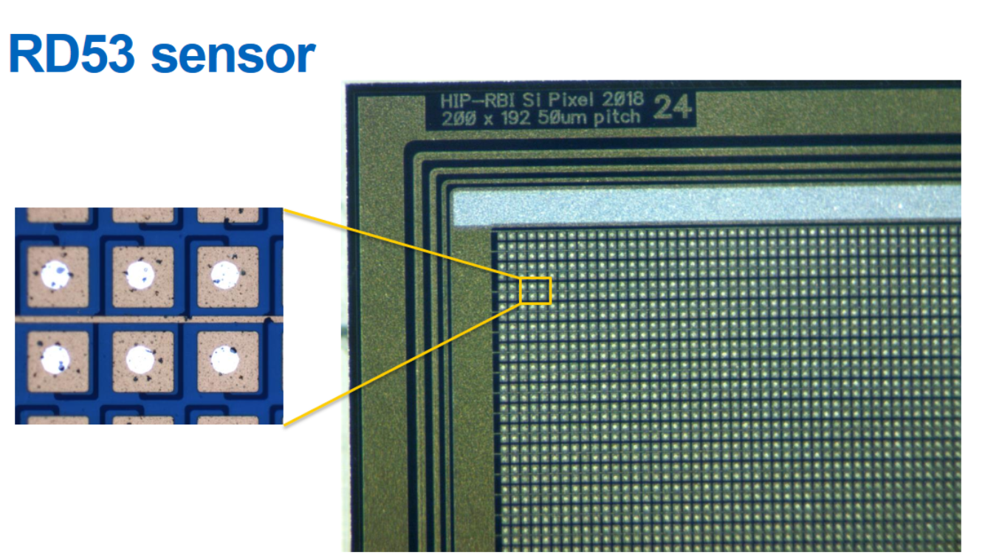
Detector design – RD53 pixel detector
38µm
Presented at 33rd RD50 Workshop, CERN, Geneva, Switzerland, November 28th 2018
J. Ott et al., Processing of pixel detectors on p-type MCz silicon using atomic layer deposition (ALD) grown aluminium oxide
https://indico.cern.ch/event/754063/contributions/3222806/attachments/1760772/2865963/JOtt_RD50_Nov18_3.pdf

Slide 5
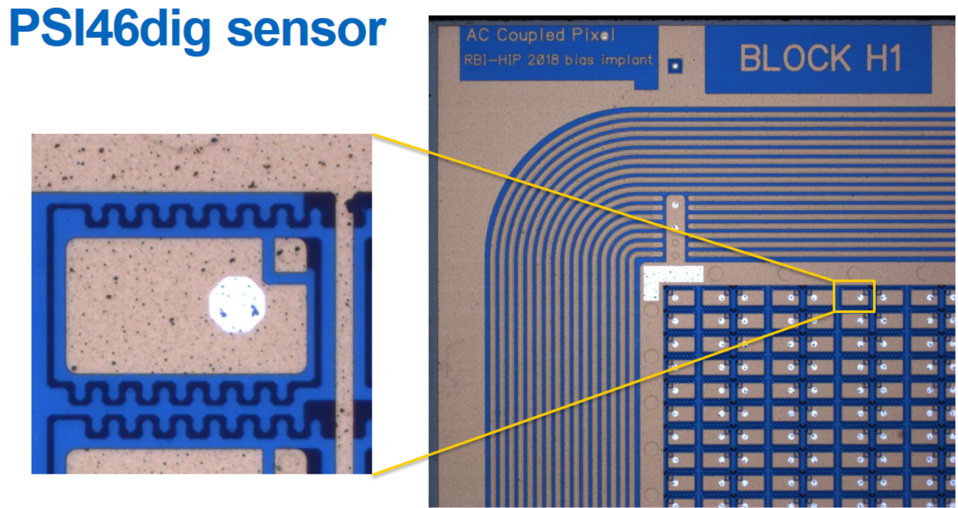
Detector design – PSI46dig pixel detector
70µm
120µm
Presented at 33rd RD50 Workshop, CERN, Geneva, Switzerland, November 28th 2018
J. Ott et al., Processing of pixel detectors on p-type MCz silicon using atomic layer deposition (ALD) grown aluminium oxide
https://indico.cern.ch/event/754063/contributions/3222806/attachments/1760772/2865963/JOtt_RD50_Nov18_3.pdf

Slide 6
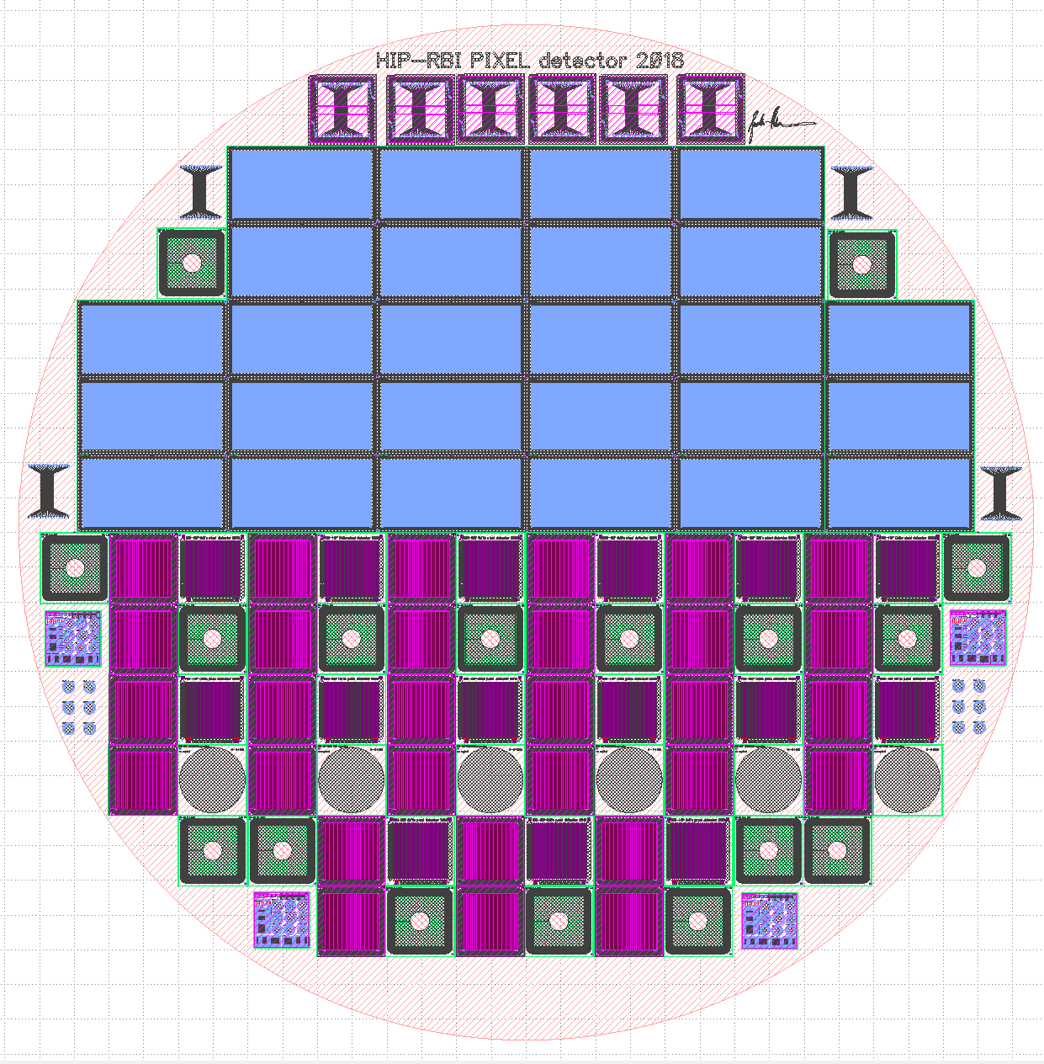
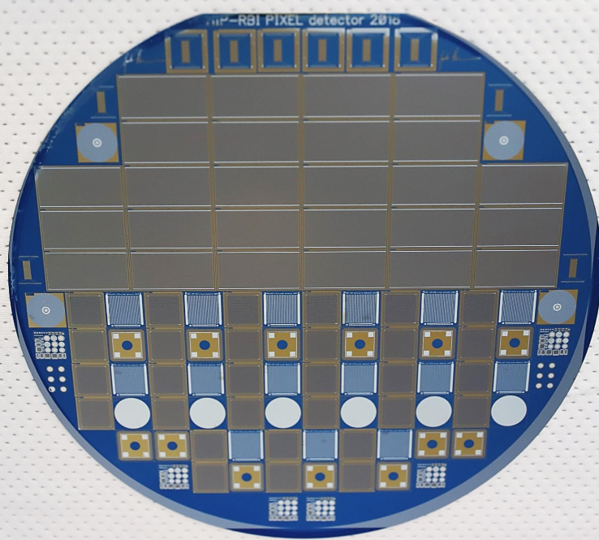
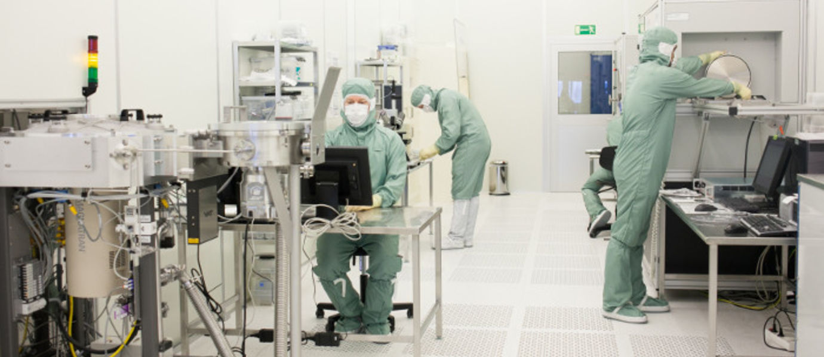
Processing of detectors

Slide 7
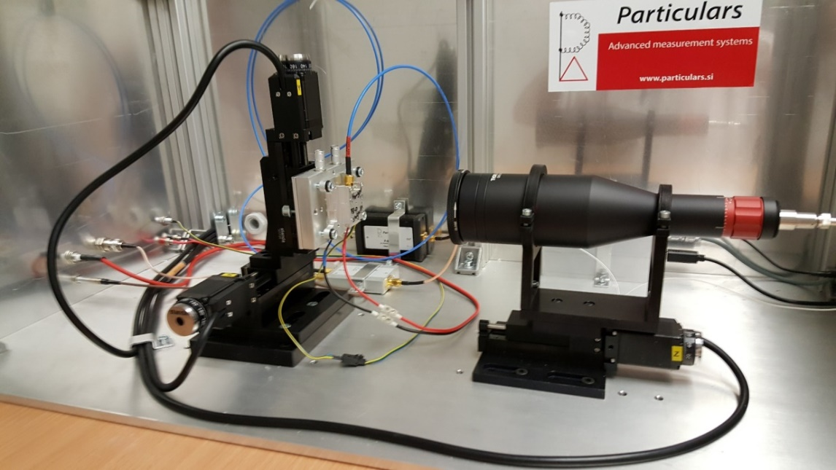
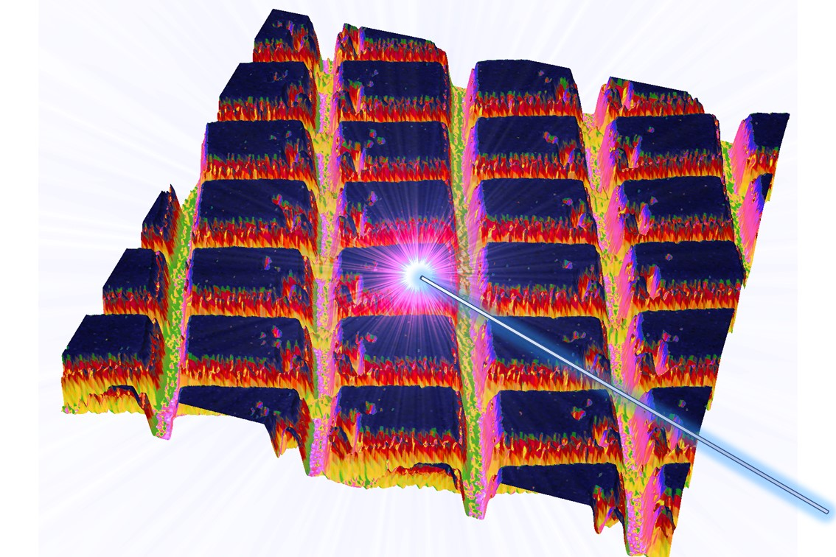
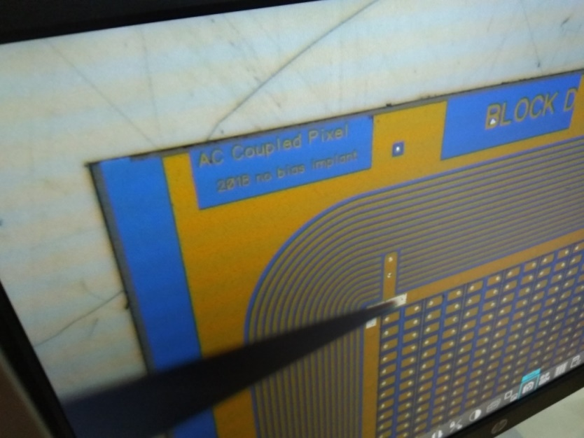
Characterization and selected results

Slide 8
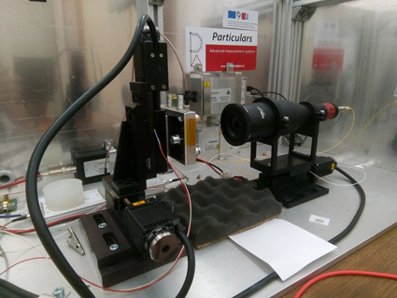
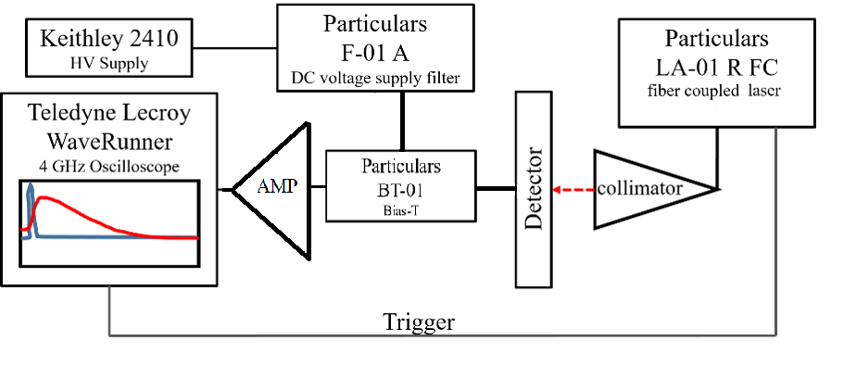
TCT-setup
Raster scanning surface TCT setup from Particulars d.o.o
Currently with two wavelengths 660 nm (red) and 1064 nm (IR)
Readout with 4 GHz Lecroy Waverunner oscilloscope

Slide 9
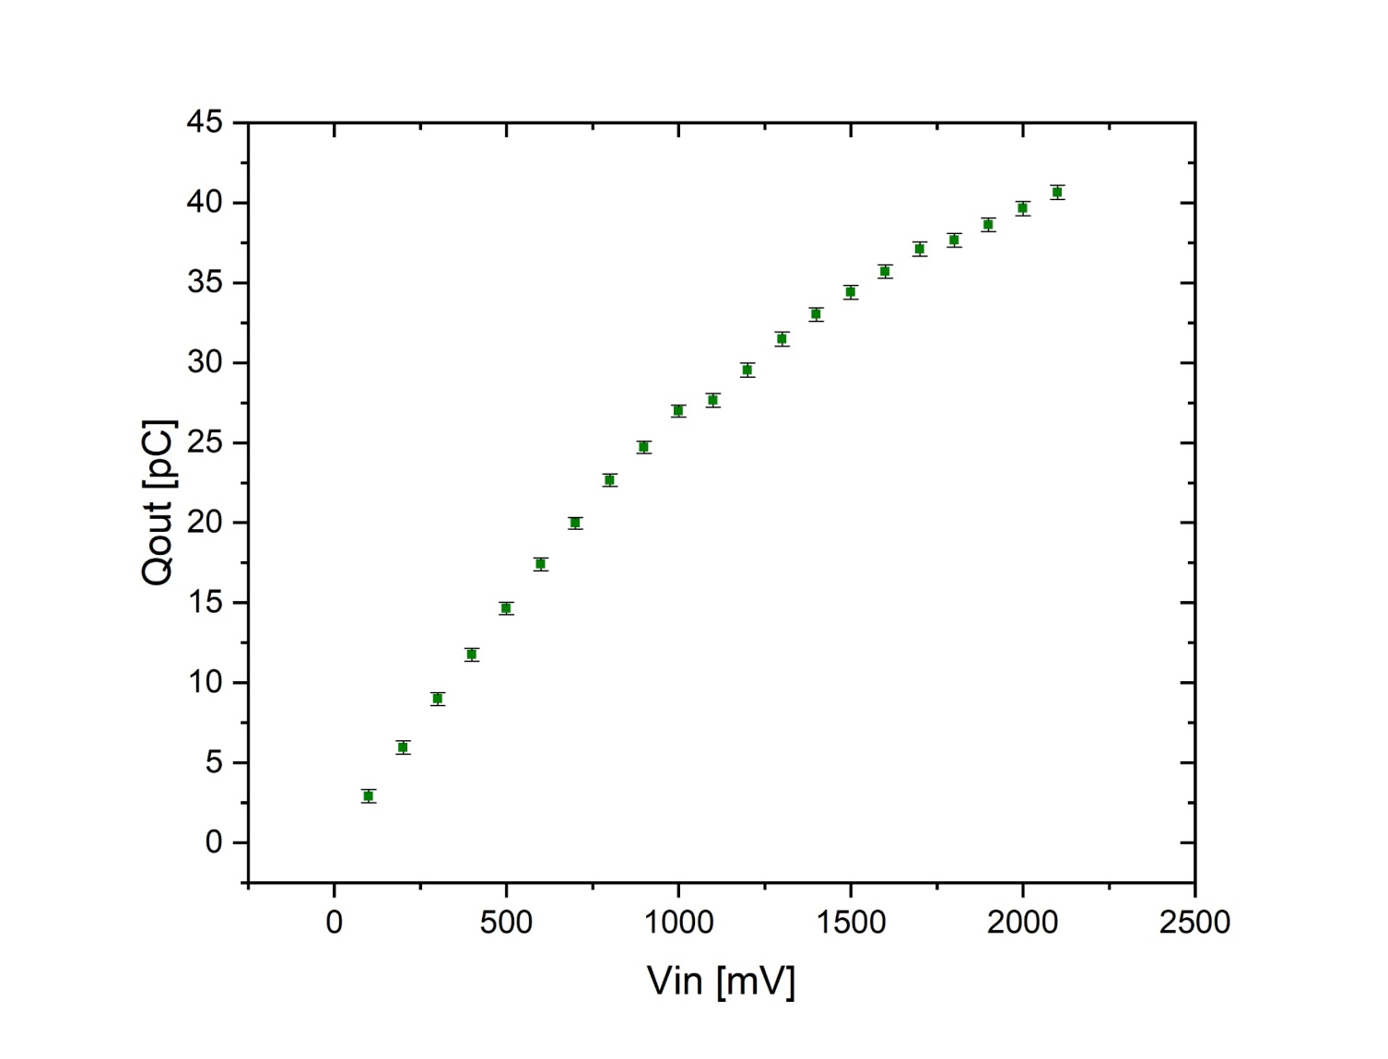
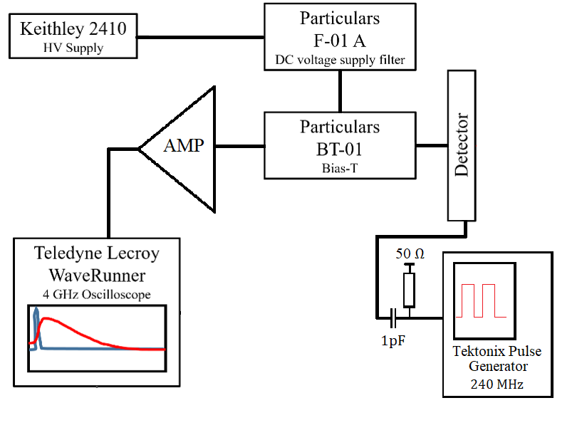
TCT- Apsolute Calibration of Amplifier
Asymetrical behavior
1000 mV – positive signal
600 mV – negative signal

Slide 10
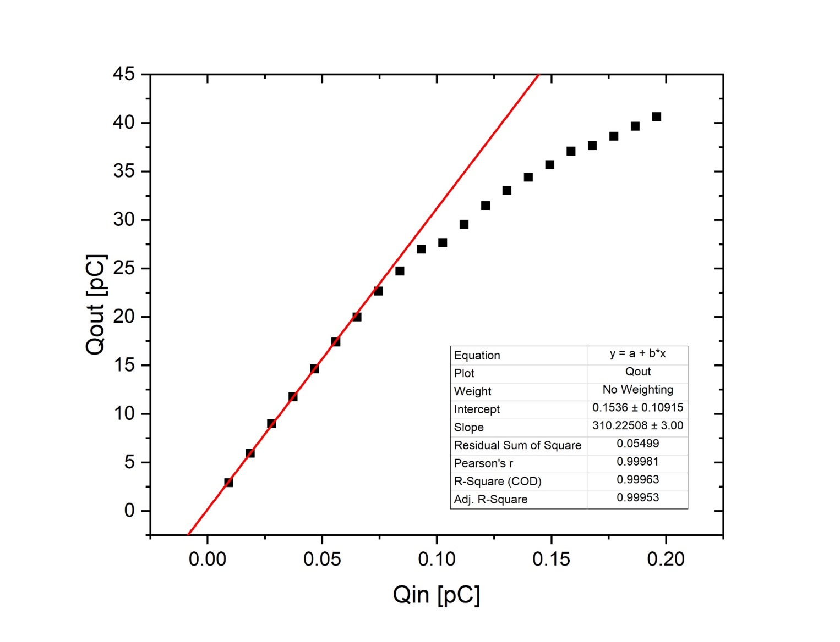
TCT- Apsolute Calibration of Amplifier
Gain of amplifier (310 ± 3) which correspondence to 50 dB
Important for translation to MIP equvivalent
* 53 dB ≈ 447 gain

Slide 11
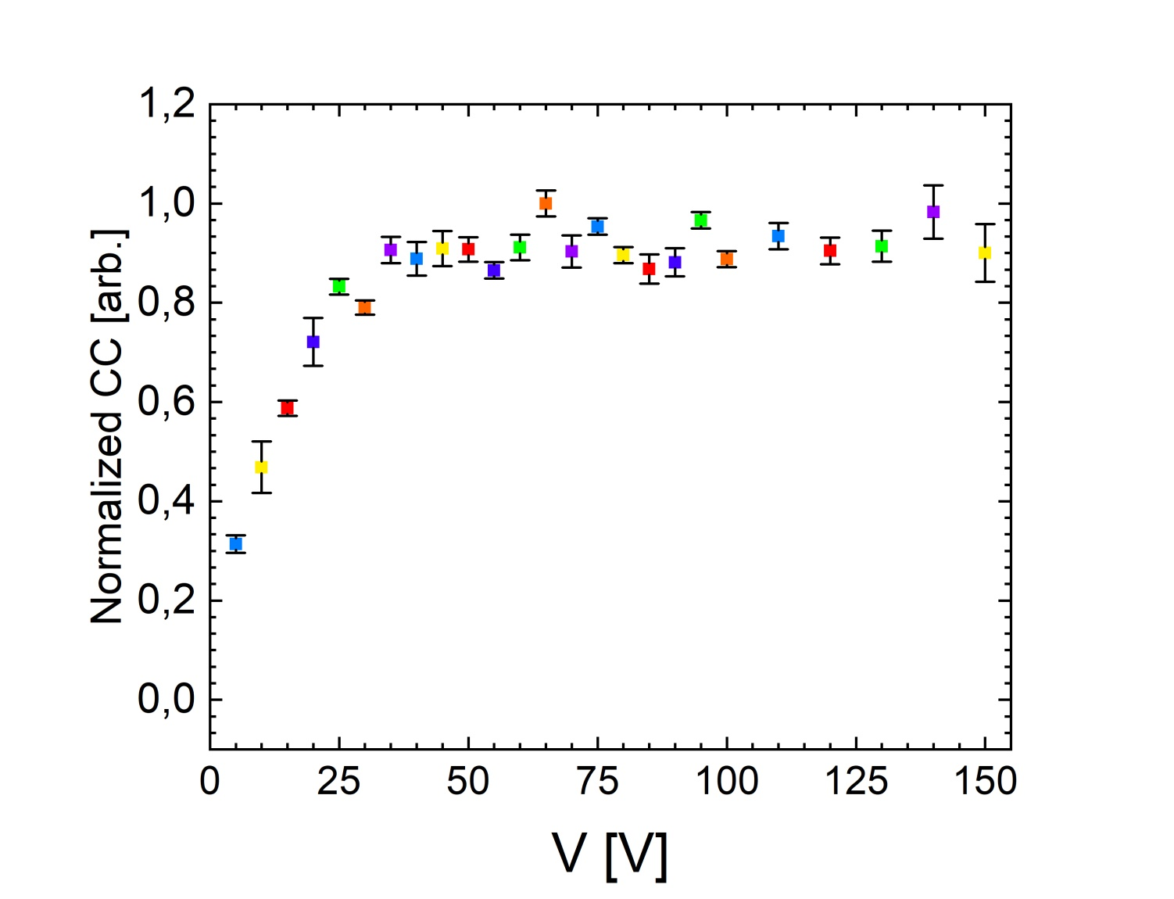
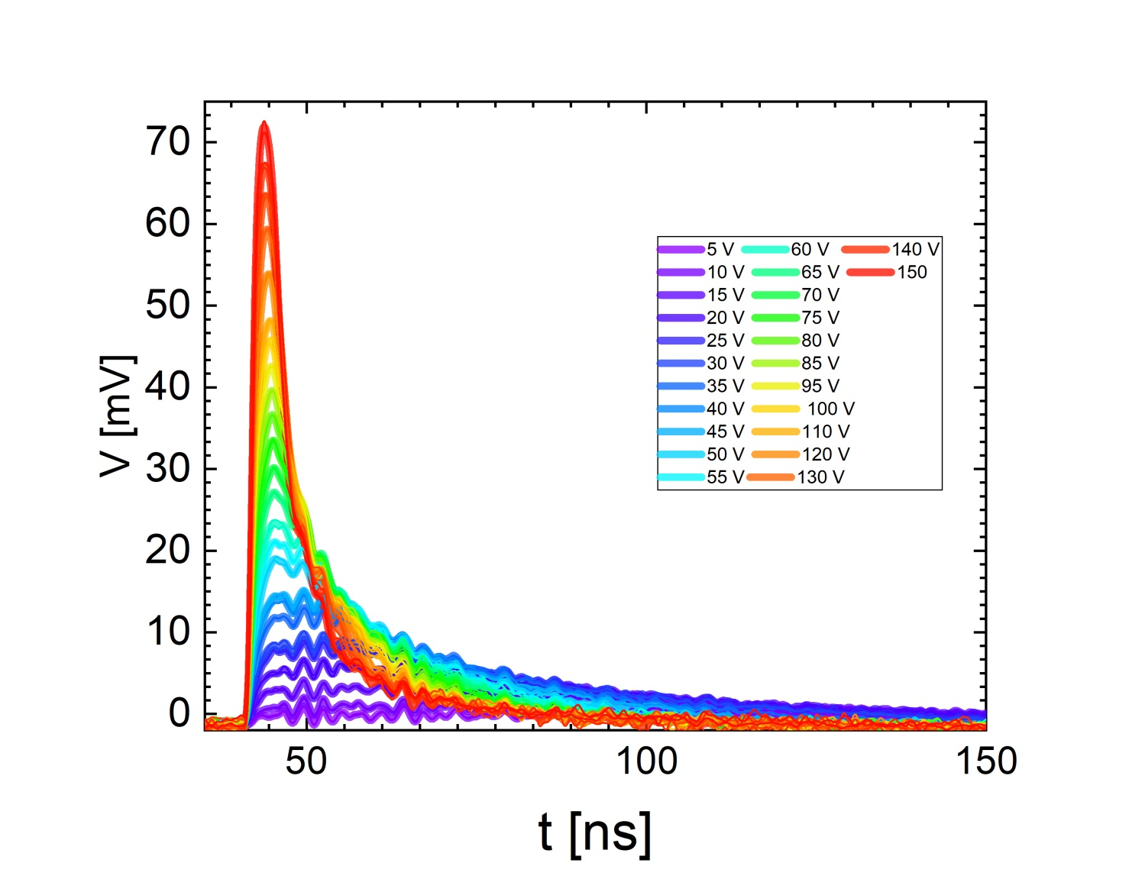
TCT Voltage Scan
Full depletion voltage V_{fd}

Slide 12
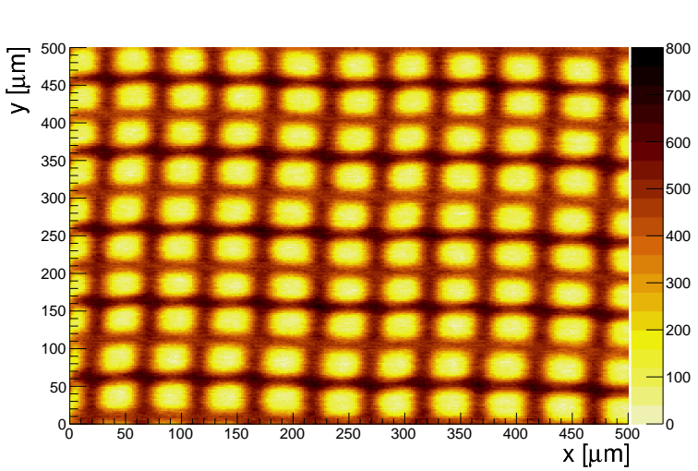
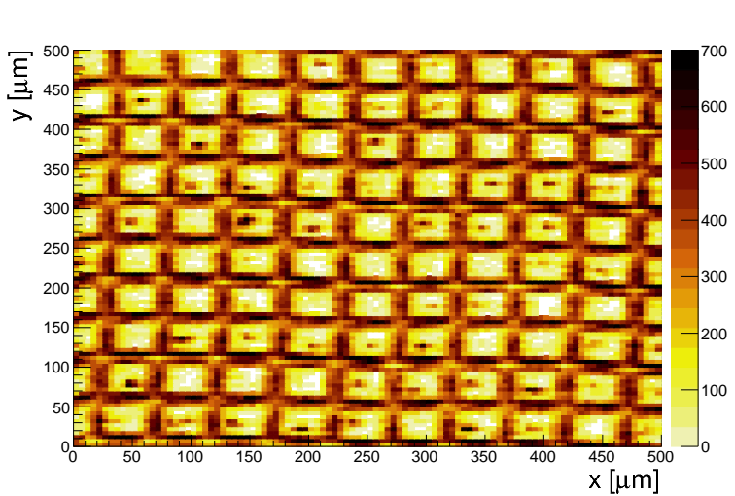
TCT Area Scans
After the optical focal distance is determined, XY-scan of the selected detector areas is made
RD53 pixel detector
100 V
1064nm
660nm

Slide 13
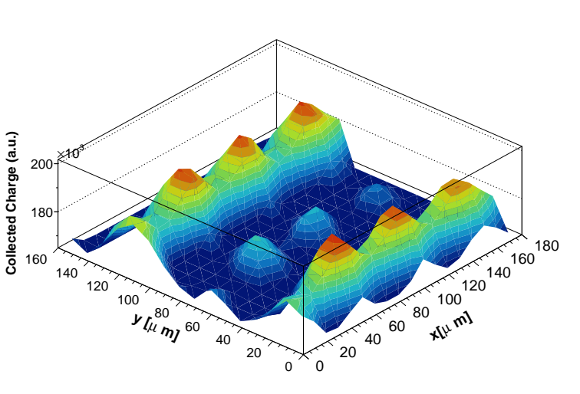
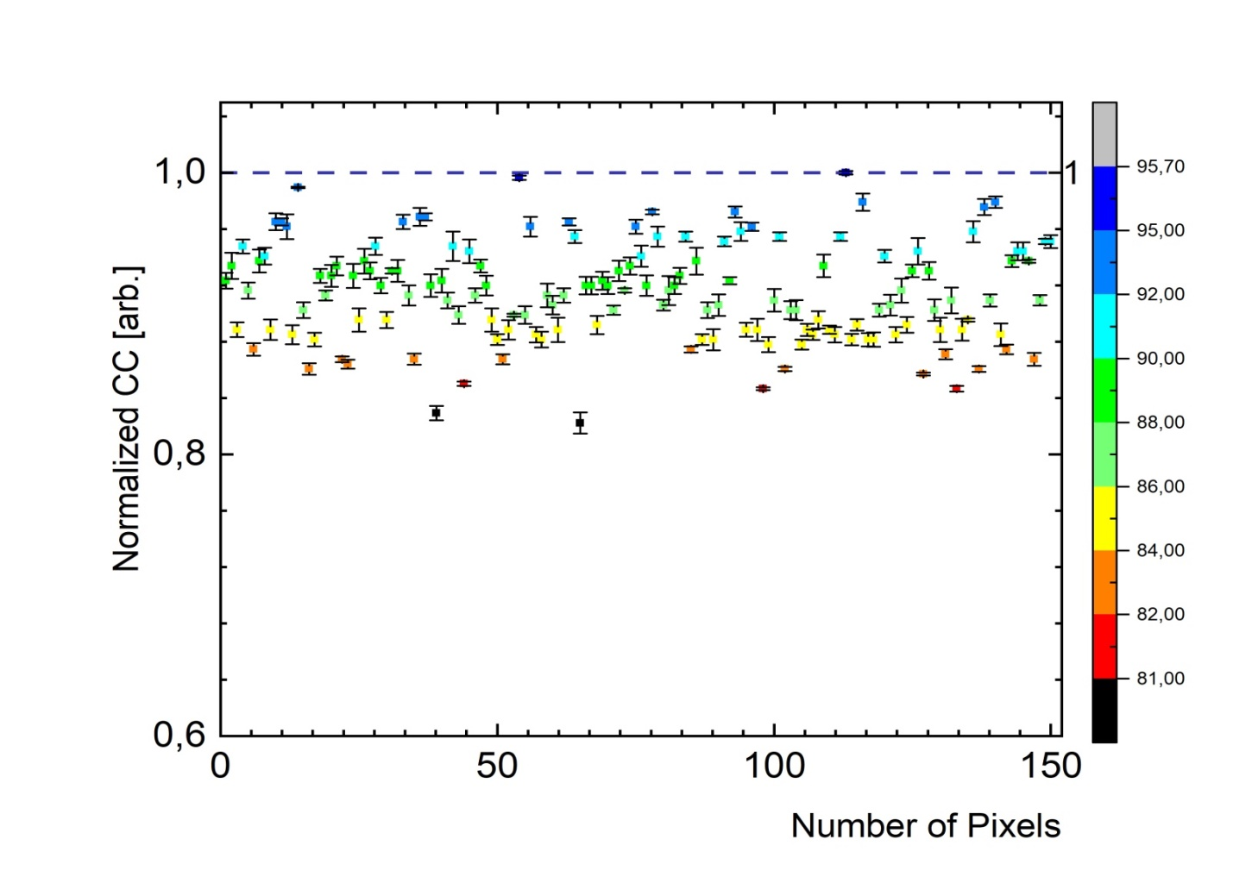
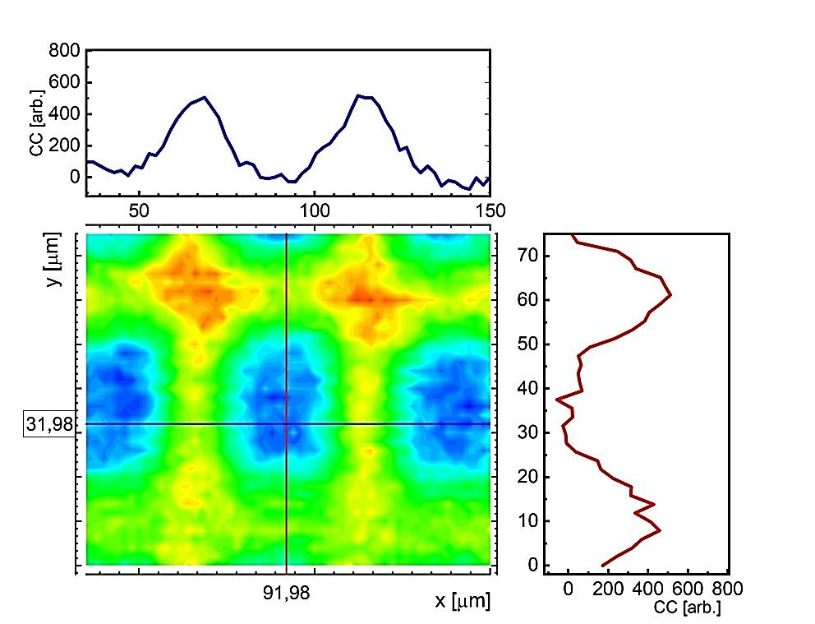
Pixel Statistics
Homogeneity of scanned pixels in terms of collected charge
Reference point – max value of collected charge

Slide 14
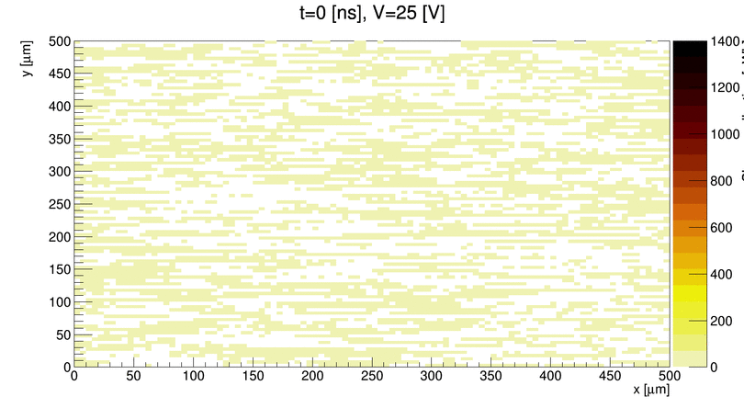
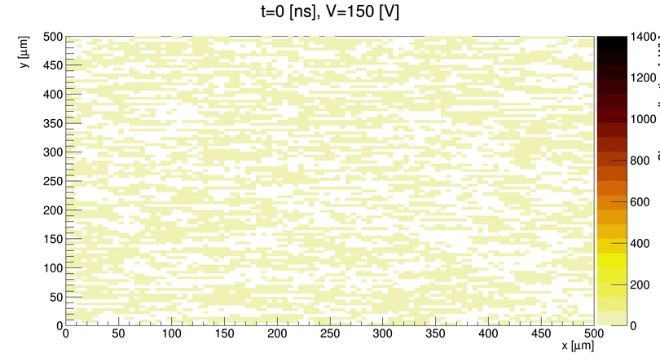
TCT Area Scans for different bias Voltages
1064nm

Slide 15
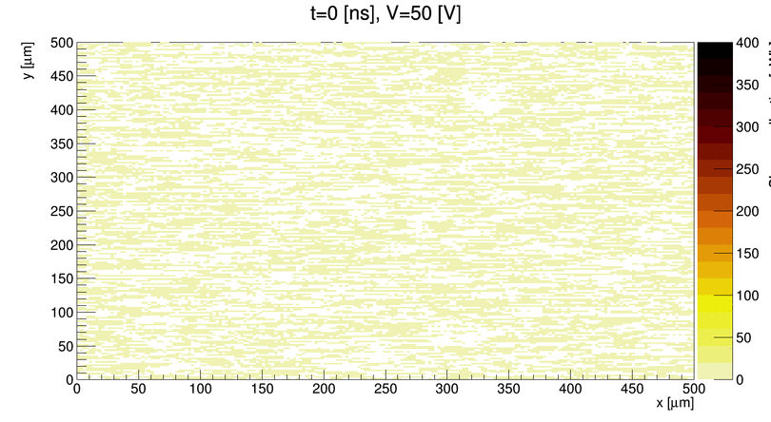
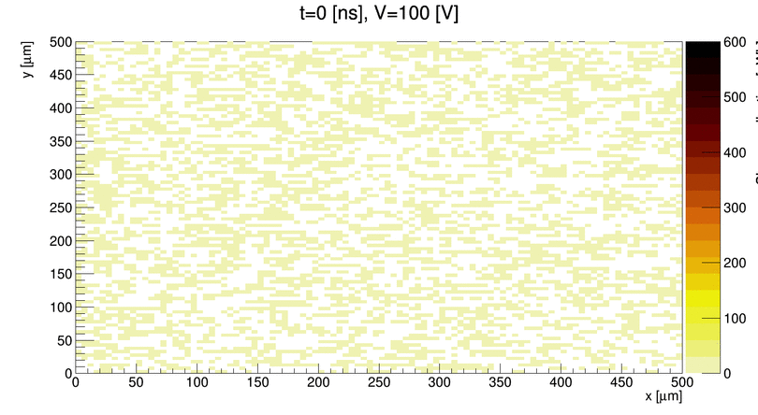
TCT Area Scans for different bias Voltages
660nm

Slide 16
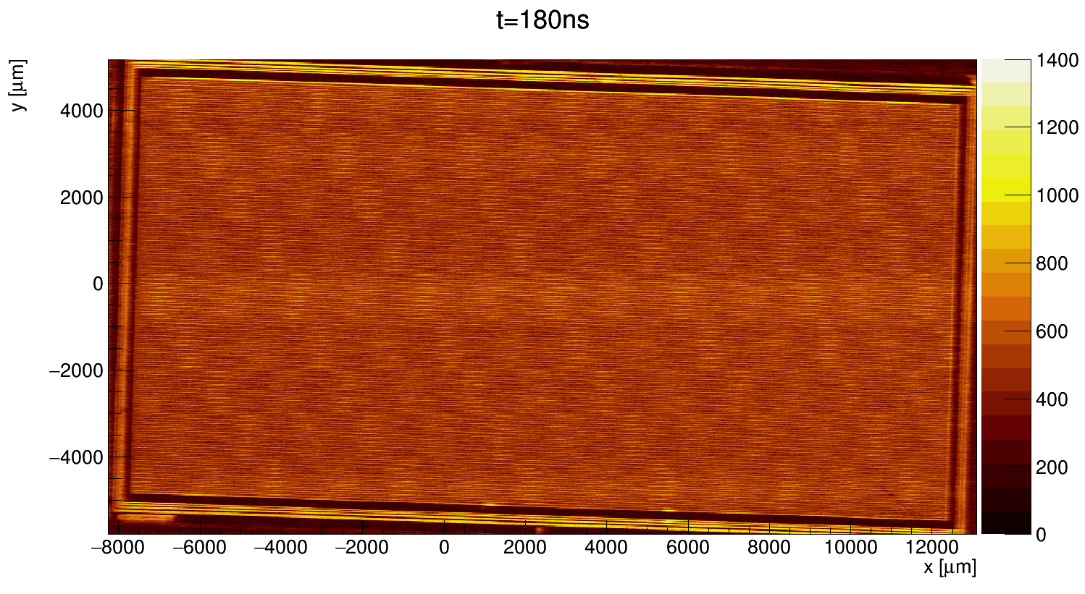
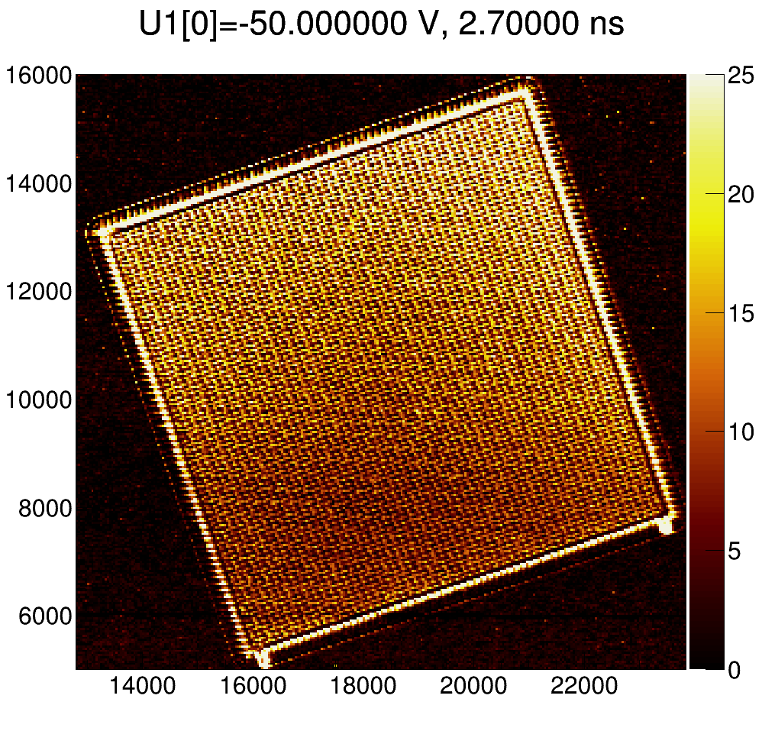
TCT Big Area Scans
1064nm

Slide 17
Big Area Scans
By performing measurments impact of mechanical (stage) movment was observed
Solutions :
Increasing the waiting time while thaking the wave forms
Applaying procesing tools - Discrete Fourier Transformat
Figure 21 360 X 10 960 μm
Waiting time t = 0.1 s
Step dr=(15,15, 0) μm
Number of points N=(1425, 548, 0)
Time of scaning 780900 points
= 21h41min24s

Slide 18
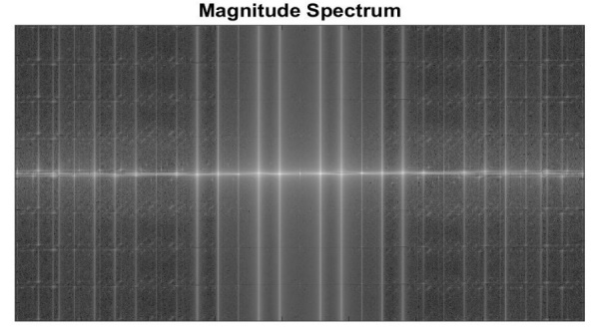
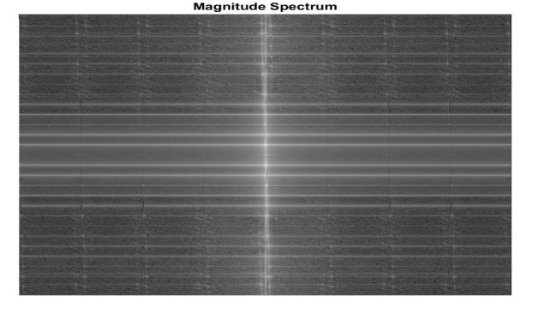
Big Area Scans - DFT
2 dim. DFT -> Magnitude Spectrum
The Fourier image is shifted in such a way that the DC-value (image mean) F(0,0) is in the center
Image contains components of all frequencies – magnitude is smaller for higher frequencies
Dominating direction – background pattern
2D DFT + SHIFT

Slide 19
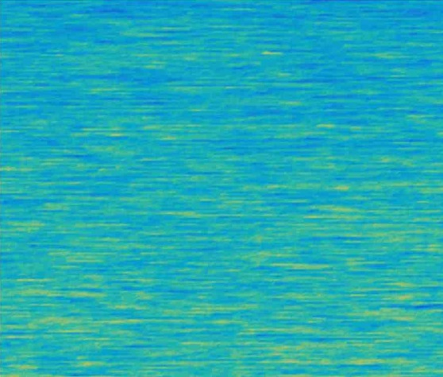
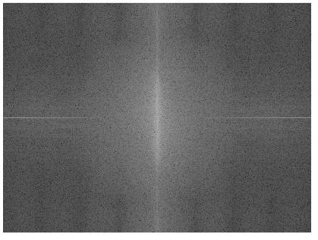
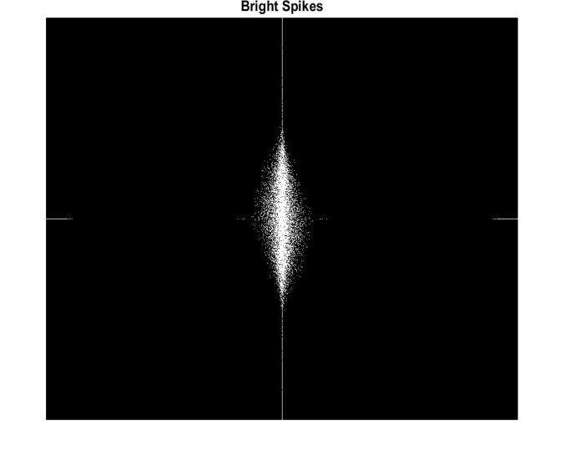
Big Area Scans - DFT
Noise image
Grey Scale
Magnitude Spectrum
Bright spikes
Inverse FFT
Coloring*

Slide 20
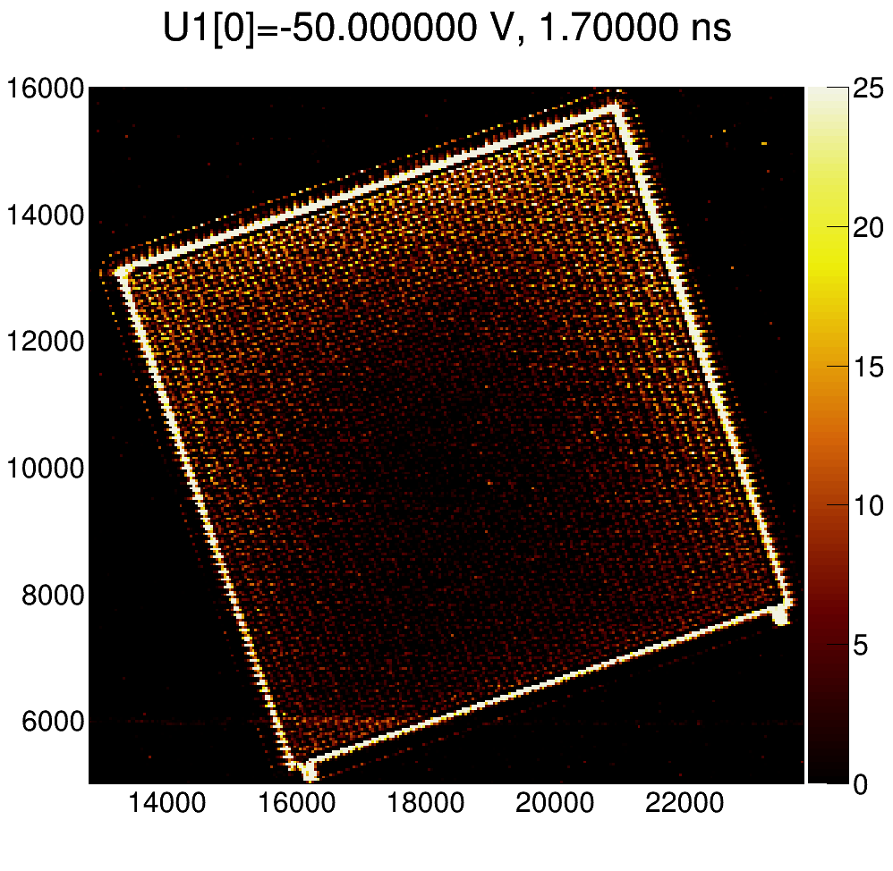
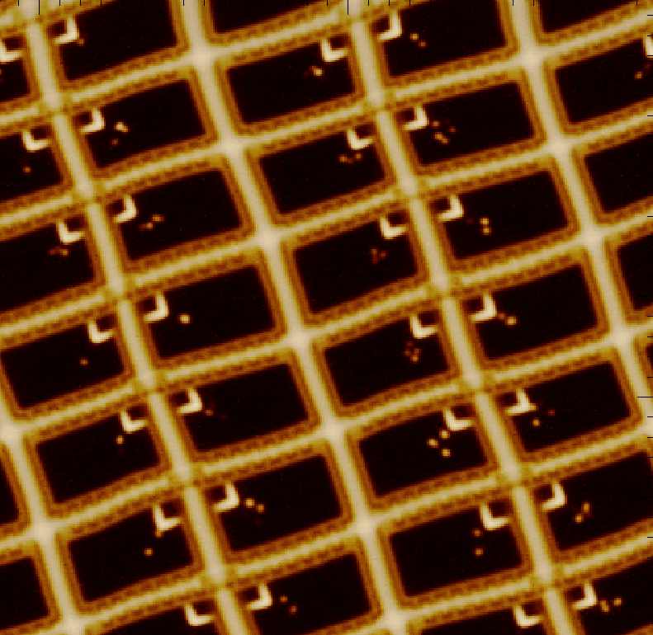
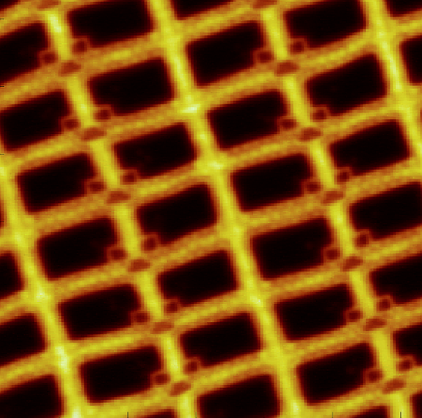
660nm
1064nm

Slide 21
Summary
Helsinki Institute of Physics (HIP) and RBI PaRaDeSeC teams have on-going common activity to develop new and innovative pixel detectors intented for CMS Phase II Upgrade
We have simulated, designed, manufactured and characterized novel fine pitch n⁺/p⁻/p⁺ pixel detectors made on 150mm size p-type Magnetic Czochralski silicon (p-MCz Si) wafers
Detectors are processed at Micronova nanofabrication
center in Finland
Atomic Layer Deposition (ALD) technology has many properties, which make it very attractive process method for radiation detectors.
TCT can be used to study the uniformity and possible radiation damage
By studiying image processing tools more detailed image of detector performance can be done

Slide 22
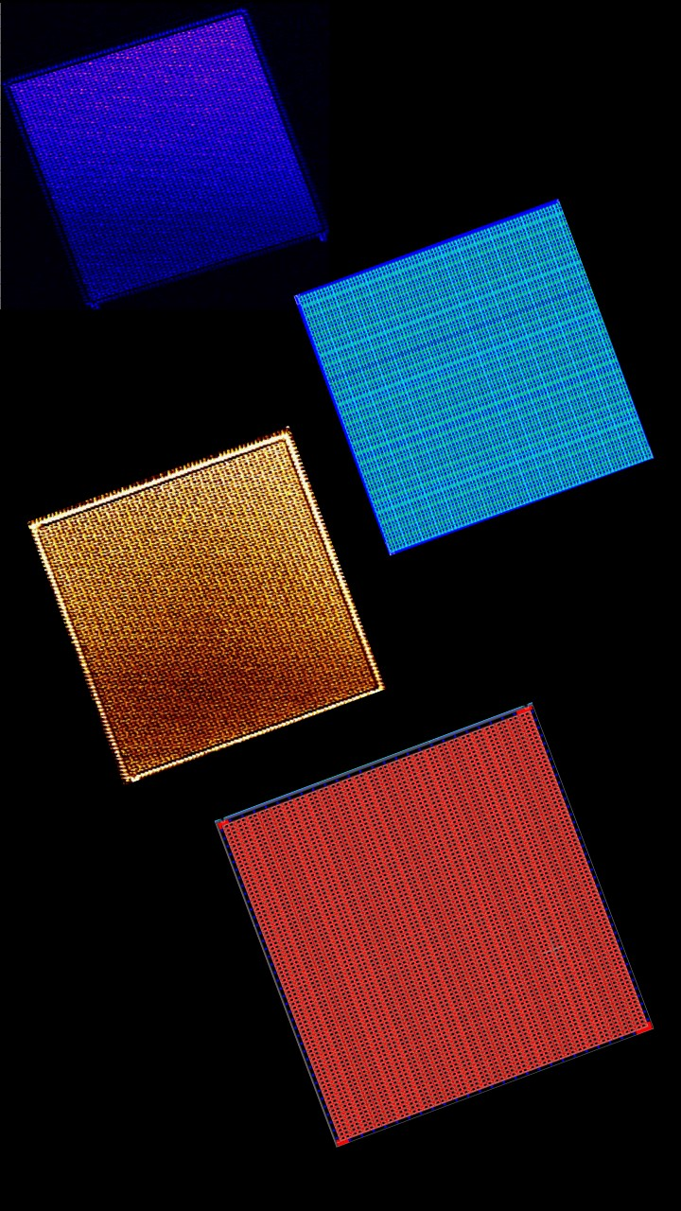
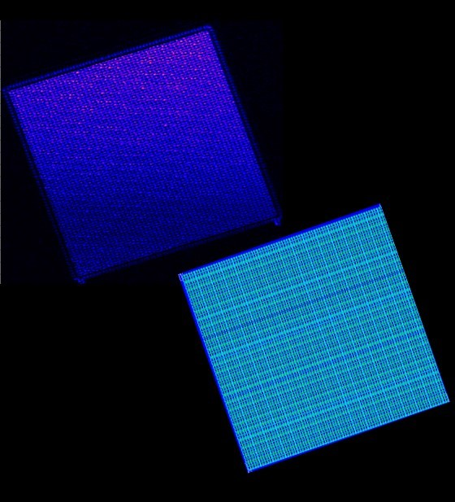
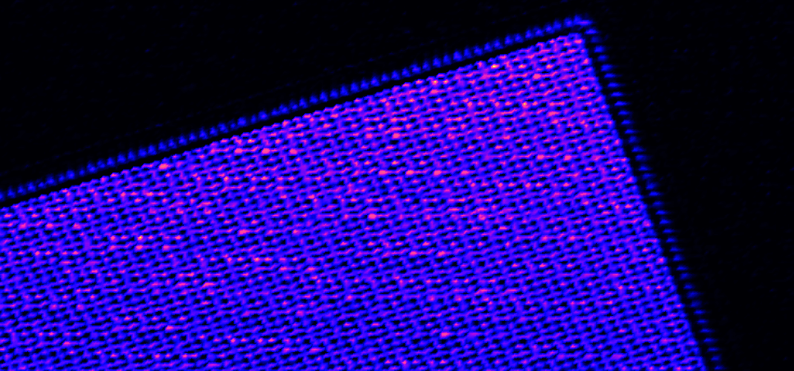
Backup slides
When pixel technology meets Arts....
Each square is TCT xy-scan of about
60 000 data points.
The amplitude of the signal is converted
into color scale.

Slide 23
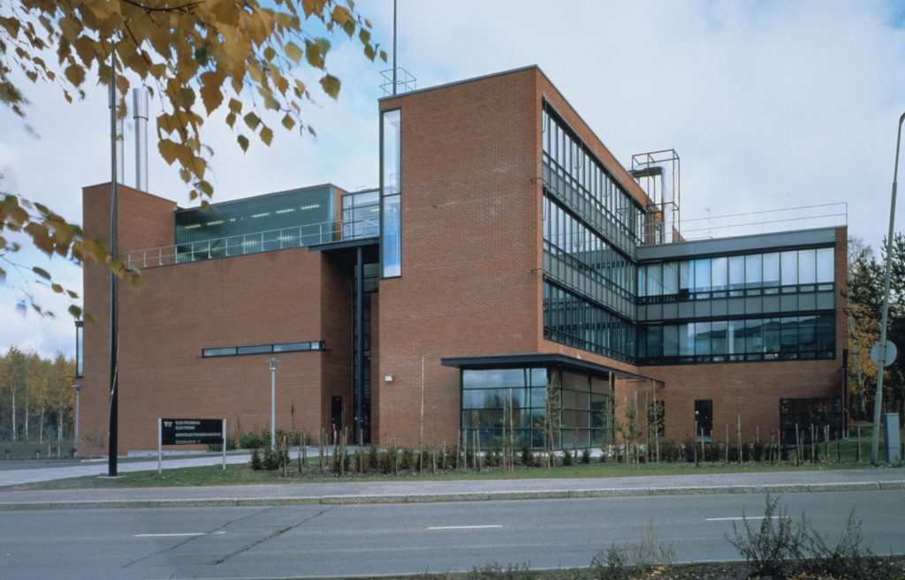
Backup slides
-Micronova facility

Slide 24
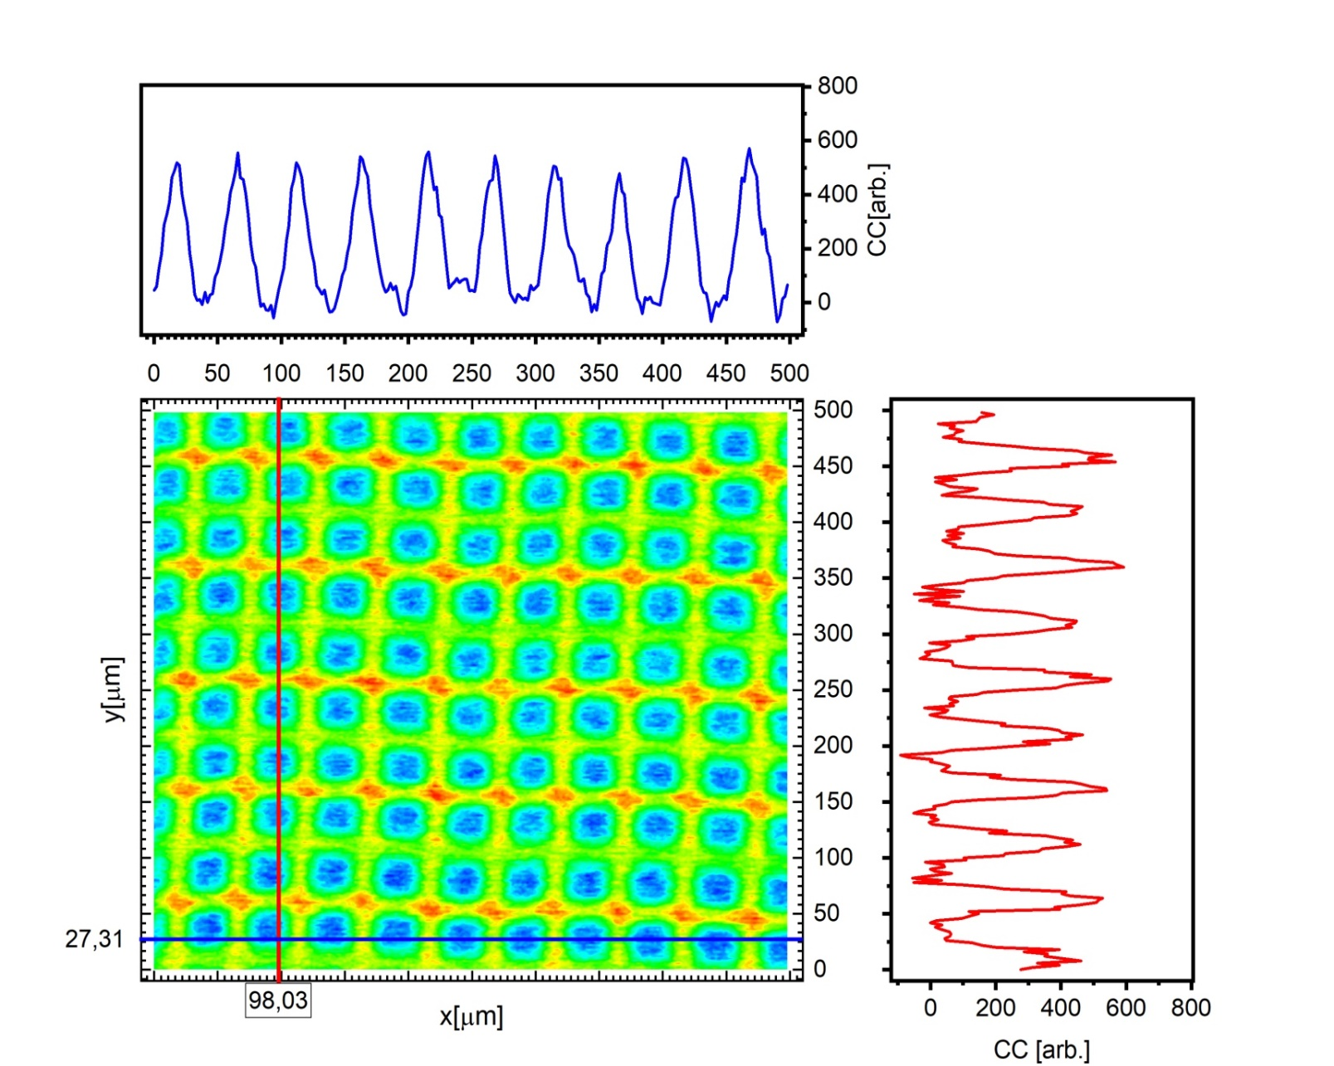
Pixel Statistics

Slide 25
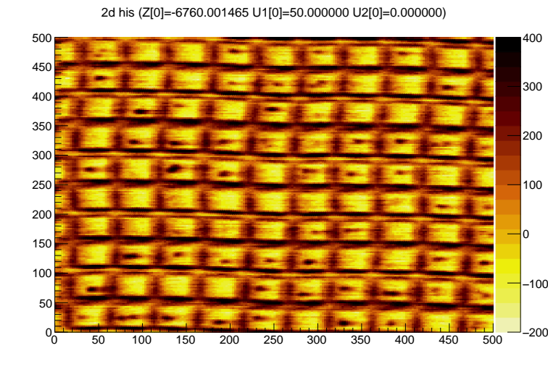
Pixel Statistics

Slide 26
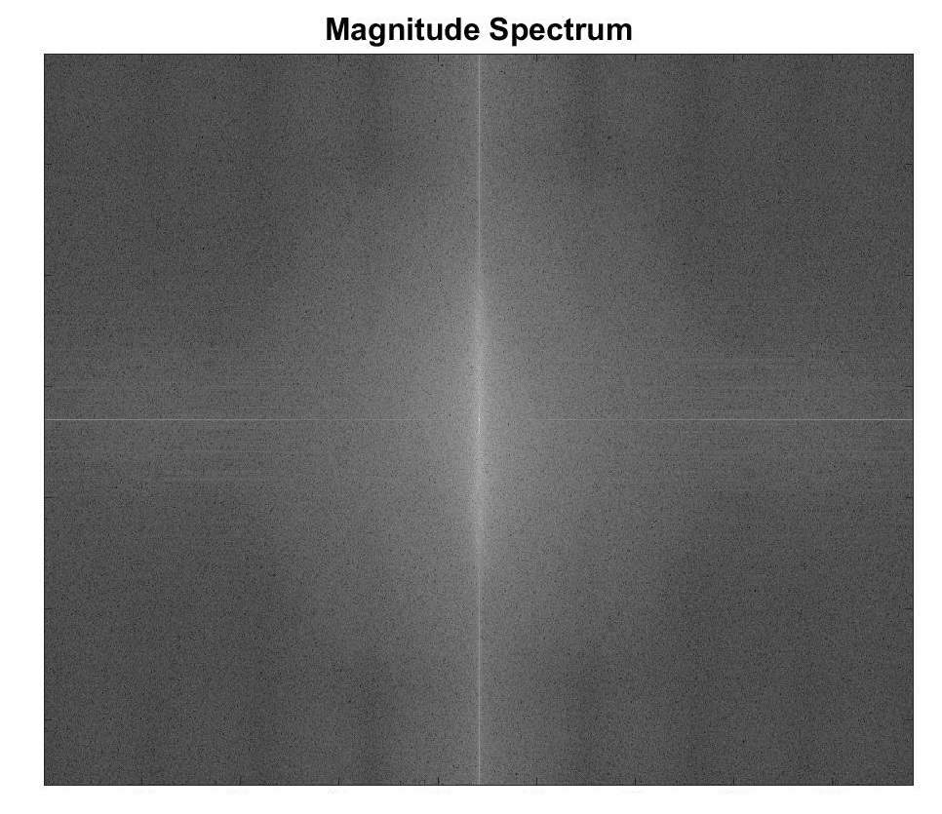
Big Area Scans

Slide 27
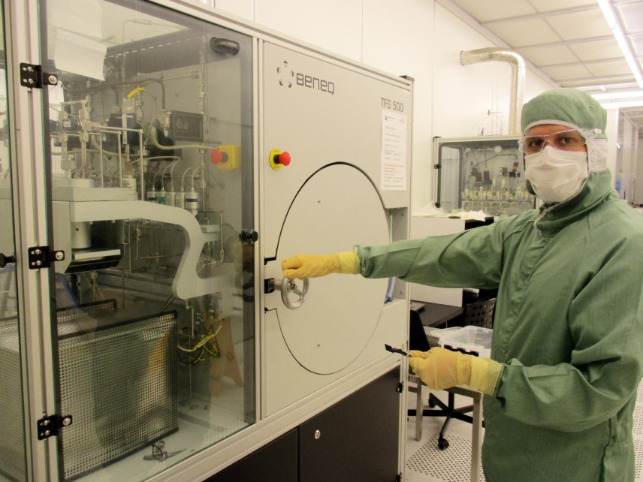
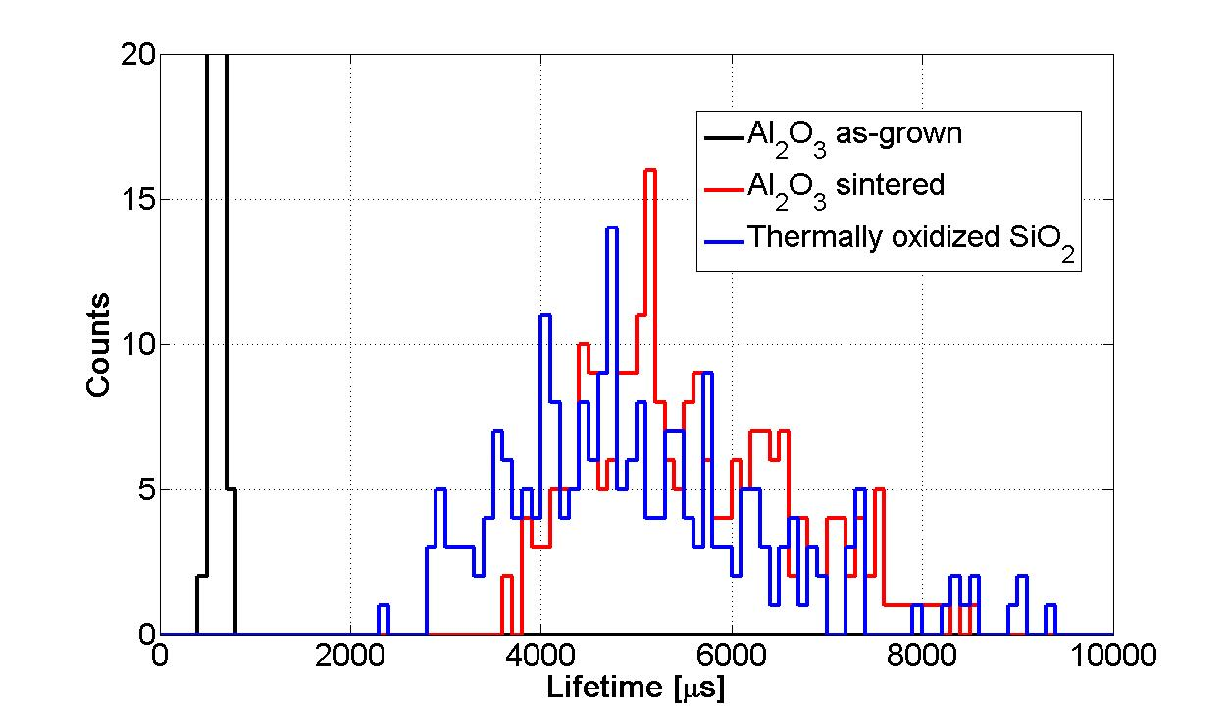
Passivation – Atomic Layer Deposition (ALD)
The electrical passivation properties
can be studied by lifetime (τ_{eff}) measurement
τ_{eff} is combination of bulk lifetime (τ_{bulk})
and surface recombination (S_{srv}).
High τ_{eff} can only be measured if S_{srv}
→ 0, i.e. Si surface is passivated.
Thermally oxidized Si-SiO₂ interface is known
to produce best possible S_{srv}→ 0
Oxidized p-type reveals bulk lifetime (τ_{bulk})
(BLUE distribution) and thus it is reference value for passivation studies.
SiO₂ is removed → ALD Al₂O₃ deposition
+ repeated lifetime measurement (RED distribution).
Good passivation (S_{srv}→ 0) is achieved by field effect, negative oxide
oxide charge in Al₂O₃ is repulsing e- to recombinate into surface states.
J. Härkönen et al., ”Processing of n+/p−/p+ strip detectors with atomic layer deposition (ALD) grown Al2O3 field insulator on magnetic Czochralski silicon (MCz-si) substrates”, NIMA 826, 2016
J. Härkönen et al., Atomic Layer Deposition (ALD) grown thin films for ultra-fine pitch pixel detectors, NIMA 831, 2016
J. Ott et al., Processing of AC-coupled n-in-p pixel detectors on MCz silicon using atomic layer deposited aluminium oxide, in VCI 2019 - The 15th Vienna Conference on Instrumentation, February 20, 2019

Slide 28
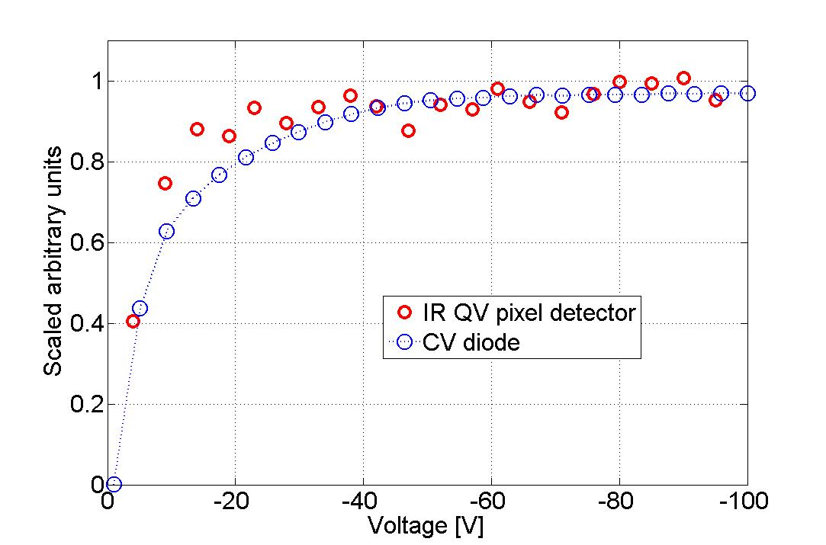
Full depletion voltage V_{fd}

Slide 29
Acknowledgements
This research has recived funding from the European Union’s Horizon 2020 ERA Chair reasearch and innovation programme under grant agreement No. 669014, PaRaDeSEC
Micronova Nanofabrication Centre

